Slide 1

Getting Started with ASP.NET Core in VS Code
@Scott_Addie

Slide 2
New Terminology (<= RC1)
DNVM (.NET Version Manager)
DNX (.NET Execution Environment)
DNU (.NET Development Utility)
Installation of DN* Tooling: http://bit.ly/1YaRWJY

Slide 3



New Choices
ASP.NET Core App
DNX
.NET Framework
dnx451, dnx452, dnx46
.NET Core
dnxcore50
Both
dnx46 & dnxcore50
IIS
Kestrel

Slide 4
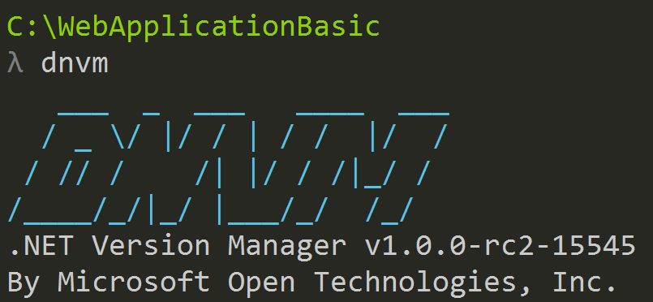
DNVM
Framework versioning manager
Registers frameworks in user profile
%USERPROFILE%\.dnx\runtimes
Runtime types:
Clr
rely on .NET being installed on machine
CoreClr
can be deployed w/ app

Slide 5
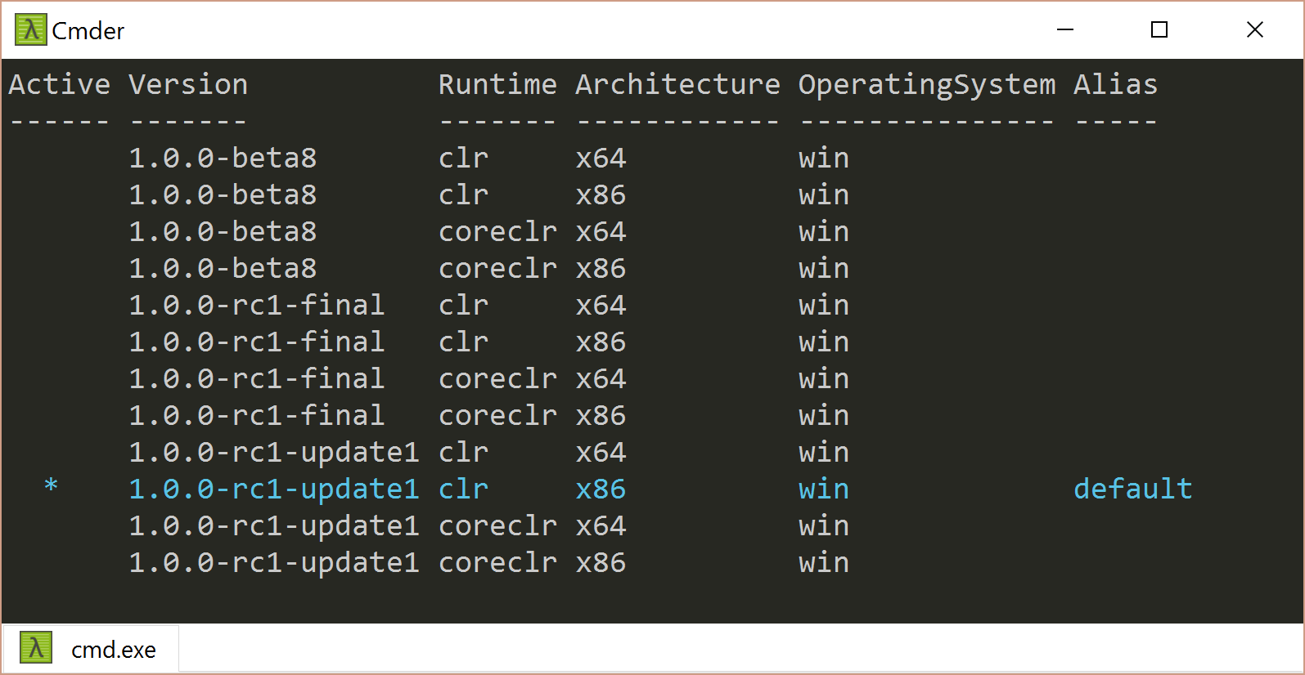
DNVM – View Framework Inventory
> dnvm list

Slide 6
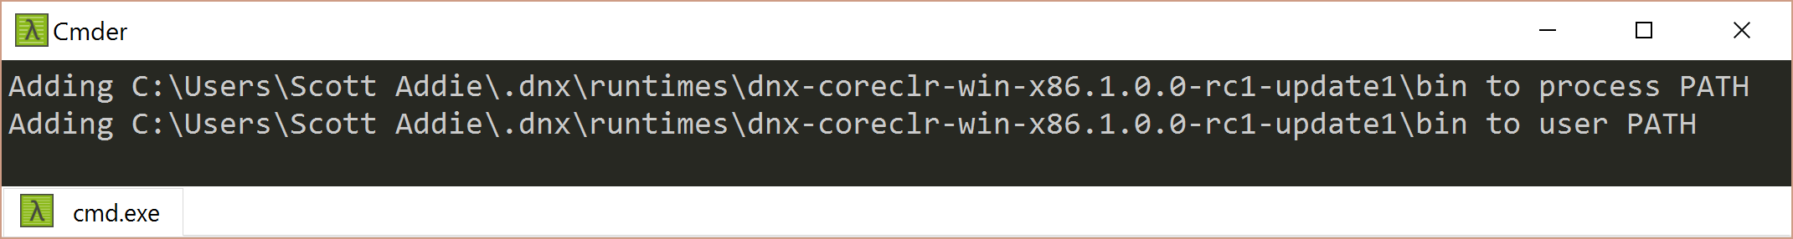
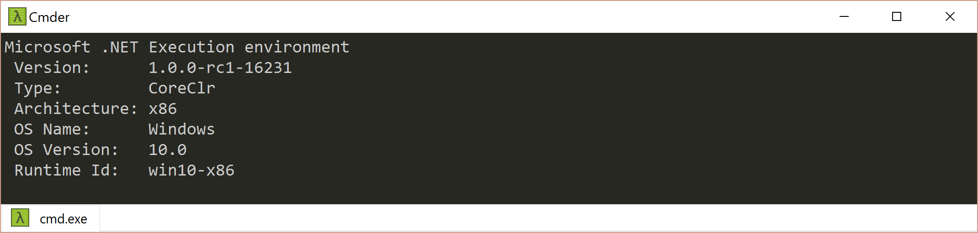
DNVM – Set Default Runtime
> dnvm use 1.0.0-rc1-update1 –r coreclr –a x86 –p
> dnx --version

Slide 7

DNX
SDK & runtime environment
Built by ASP.NET team to make framework:
X-plat
Windows, Mac OSX, Linux
Runtime agnostic
.NET Core, .NET Fx, Mono, etc.
Introduced a confusing new .NET application model
ASP.NET Console App
Not a rapper from the late ‘90s

Slide 8
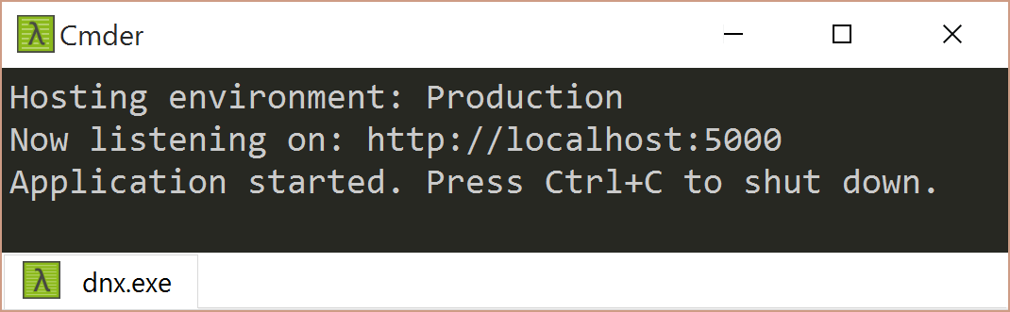
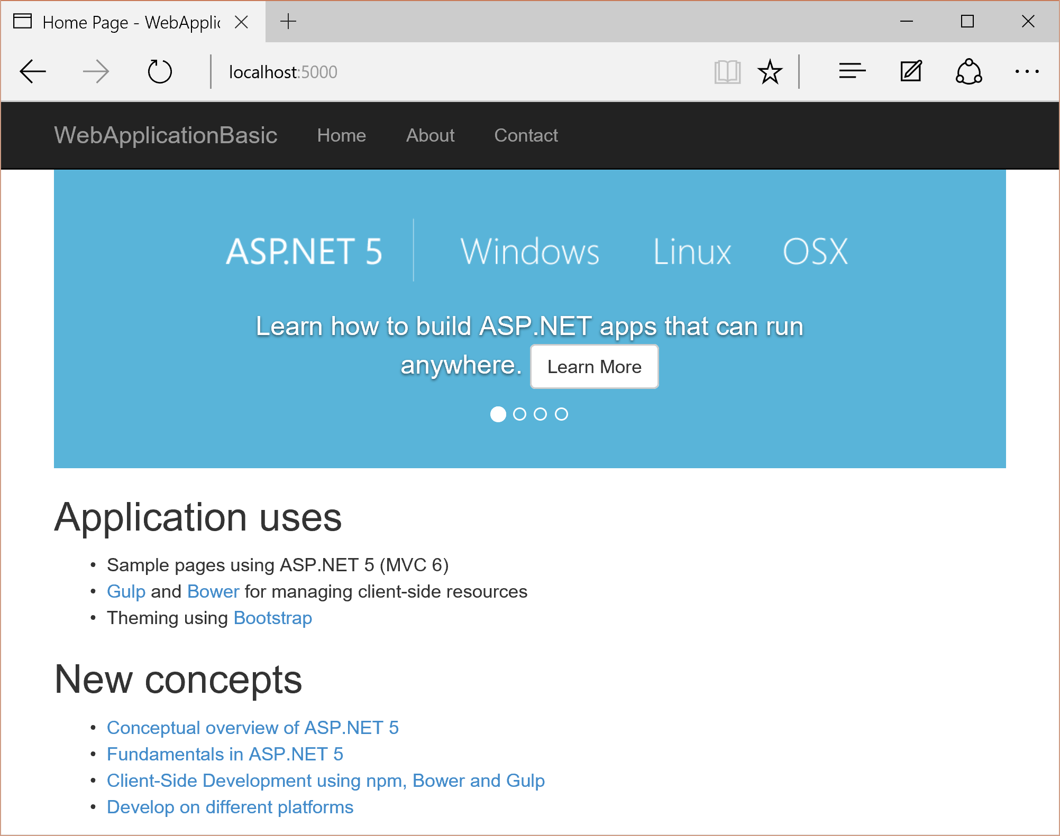
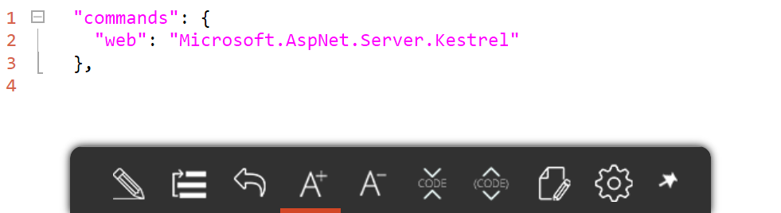
DNX – Start Web Server
project.json
> dnx web
Execute
Start
Browse

Slide 9
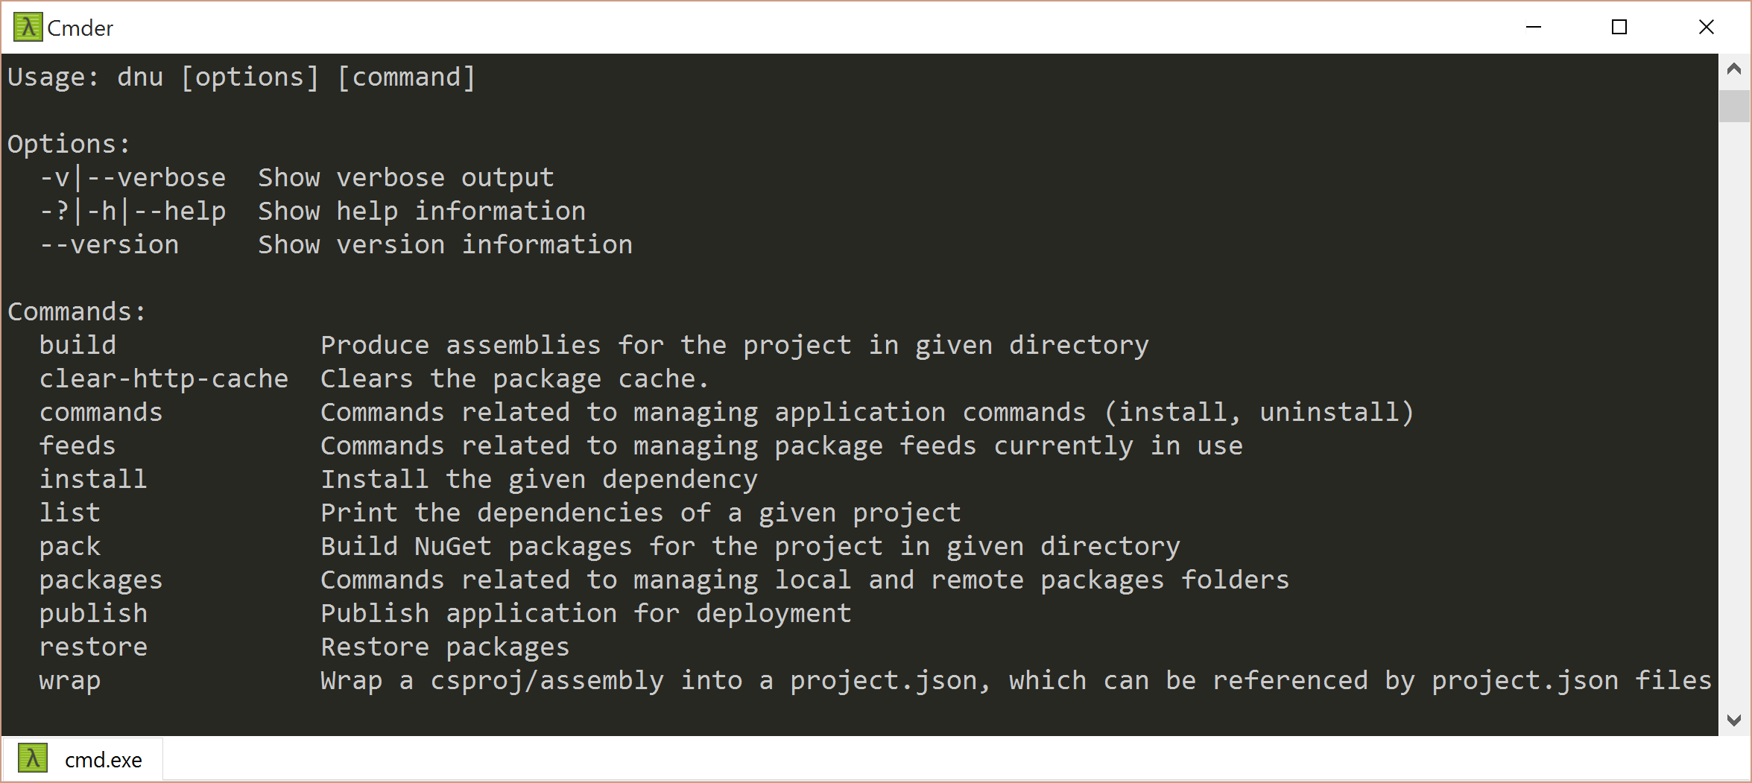
DNU
NuGet Package Restore
> dnu restore
Build App
> dnu build
Commands Management
> dnu install
Publish App
> dnu publish

Slide 10
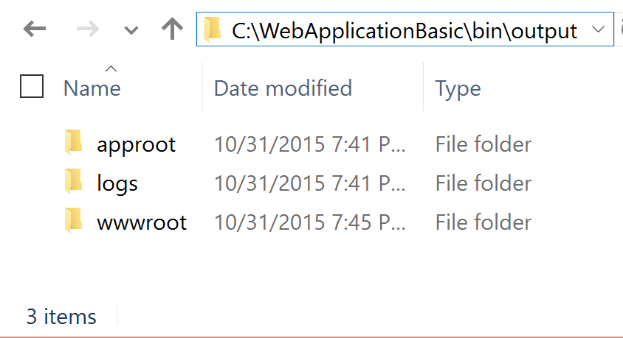
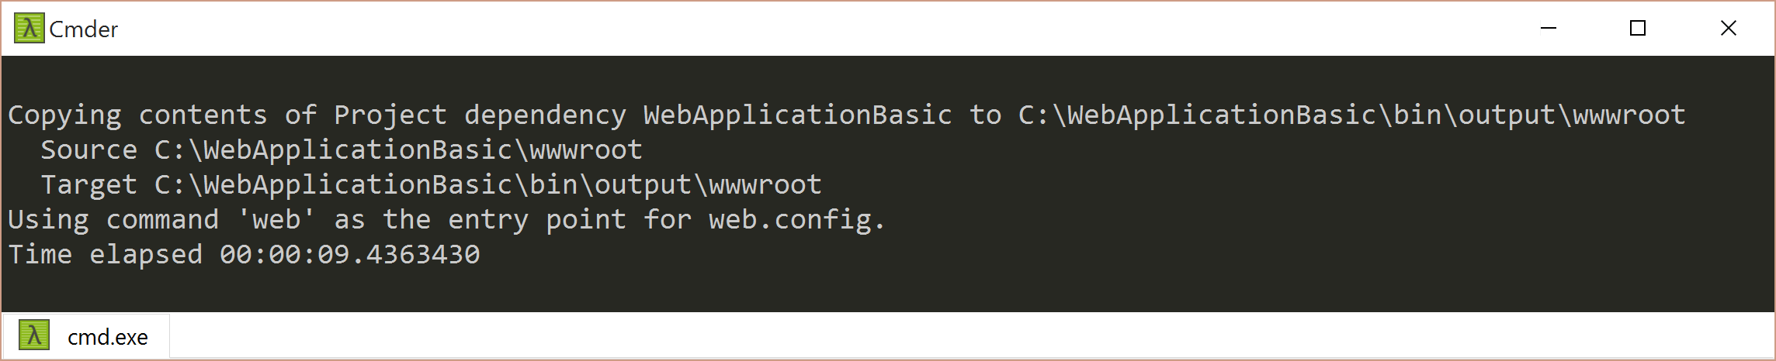
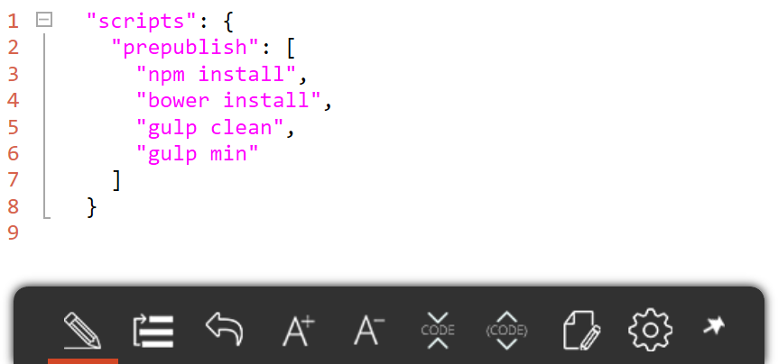
DNU – Publish App
project.json
Execute
> dnu publish
Publish
Write

Slide 11
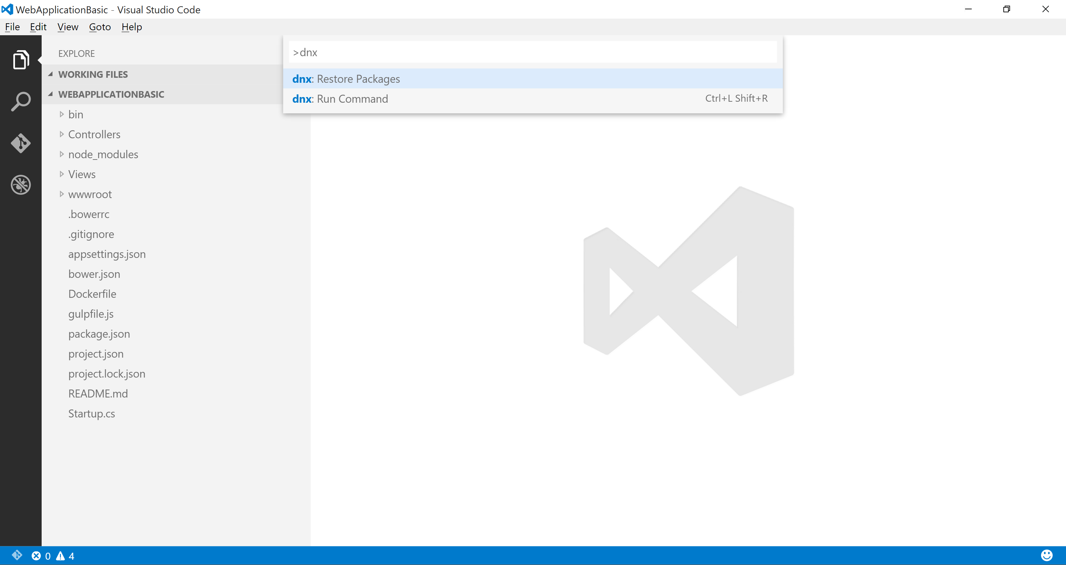
DN* Support in VS Code
Command Palette (F1)
> dnu restore
> dnx web

Slide 12
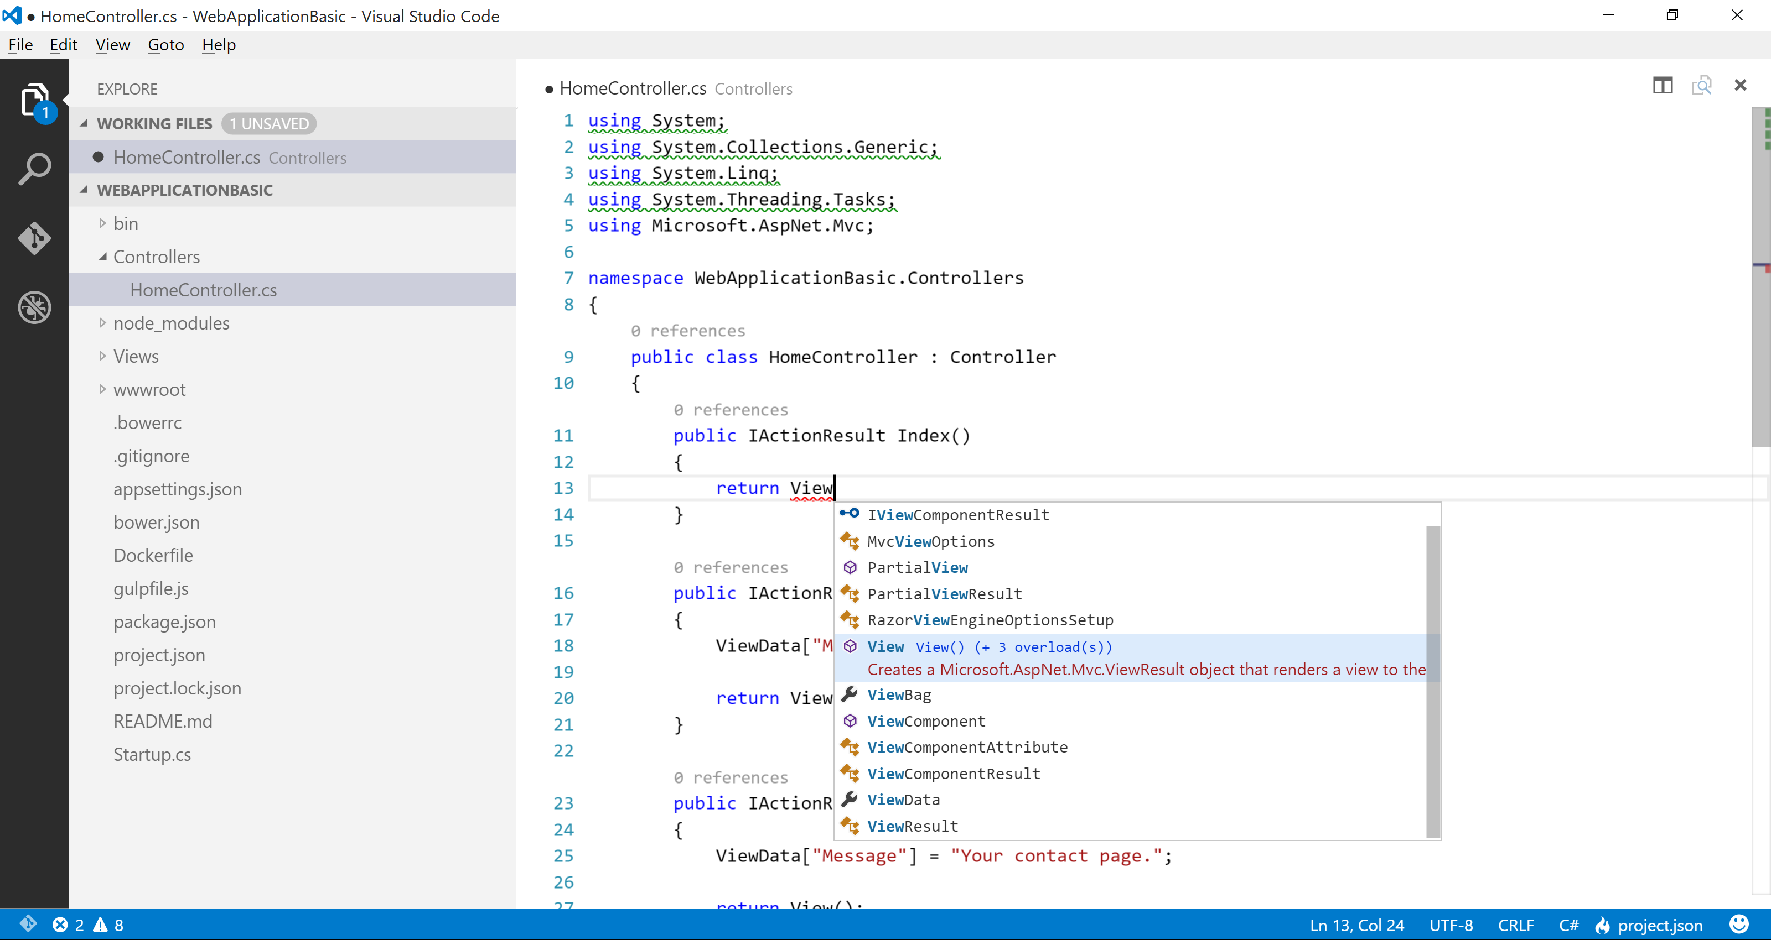
C# Support in VS Code
Unused References
Code Lens
IntelliSense
OmniSharp Integration

Slide 13



Scaffolding Support
OmniSharp
Yeoman
generator-aspnet

Slide 14
Scaffolding via Command Shell
generator-aspnet

Slide 15
Scaffolding in Command Shell

Slide 16
Scaffolding in Editor
vscode-yo

Slide 18

Platform Evolution up to RC2
KRuntime
XRE
DNX
.NET Core CLI

Slide 19
CLI Evolution for RC2
DNU
DNX
DNVM
> dotnet

Slide 20
DNX-to-dotnet Command Mappings
Old | New
dnu restore | dotnet restore
dnu pack | dotnet pack
dnu build | dotnet compile/build
dnu publish | dotnet publish
dnu run | dotnet run
dnx-watch | dotnet watch
dnx ef | dotnet ef
dnx test | dotnet test
user-secrets | dotnet user-secrets

Slide 21
> dotnet CLI Demo
ASP.NET Core Web Application in VS Code

Slide 22





Thank you!
Scan QR for slides & code:
Contact
GitHub.com/scottaddie/vscode-aspnet5
ScottAddie.com
@Scott_Addie
LinkedIn.com/in/scottaddie

